Slide 1


ZOMATO
SALES DATA ANALYSIS
KOUKUTLA SOWMYA
20/07/2025

Slide 2

PROBLEM STATEMENT
YOU HAVE BEEN HIRED AS A CONSULTANT DATA ANALYST BY ZOMATO, WHERE THE TEAM IS EXPLORING OPPORTUNITIES FOR EXPANSION BY OPENING NEW RESTAURANTS. YOUR ROLE IS TO PROVIDE STRATEGIES AND RECOMMENDATIONS TO GUIDE THIS EXPANSION EFFECTIVELY.
.

Slide 3
DATA OVERVIEW
1.There is a total of 9542 restaurants worldwide.
2.Most of the restaurants were opened in the year 2018.
3.We can see that most restaurants have online deliveries and table bookings.
4.Restaurants have a price range between 1- 4.
5.Different restaurants have different ratings based on their cities cuisines and price range.
Key Metrics:
Ratings & Voters: Customer feedback and engagement.
Price Range: Average cost for meals.
Location: Countries and cities where restaurants are located.
Services: Availability of table booking and online delivery.

Slide 4

DATA CLEANING APPROACH
Data Cleaning Approach:
1.There are 9 blank cells found in the column cuisines and those rows with blank cells are removed
2.All currencies are updated in the Indian Rupees in the new column created named Average_cost_for_two(INR)
3.Year is extracted from the column Datekey_Opening.
4.Rating Range is extracted from Rating column

Slide 5
INTRODUCTION
This project focuses on analyzing Zomato’s restaurant data to identify the best opportunities for opening new restaurants in profitable and sustainable locations. By studying customer preferences, demographic trends, location demand, competition levels, cuisine popularity, and customer feedback, the analysis provides valuable insights for strategic decision-making. The aim is to help restaurant owners and investors choose the right locations, design appealing menus, improve operational efficiency, and plan for long-term growth while keeping up with evolving customer tastes and sustainability practices.

Slide 6




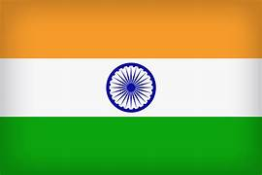
SUGGESTED COUNTRIES
QATAR
CANADA
SINGAPORE
SRI LANKA
INDIA

Slide 7
CITIES IN SUGGESTED COUNTRIES
QATAR -DOHA
CANADA - CONSORT, YORKTON
SINGAPORE - SINGAPORE
SRI LANKA - COLOMBO
INDIA- GHAZIABAD, AURANGABAD, ALLAHABAD.

Slide 8
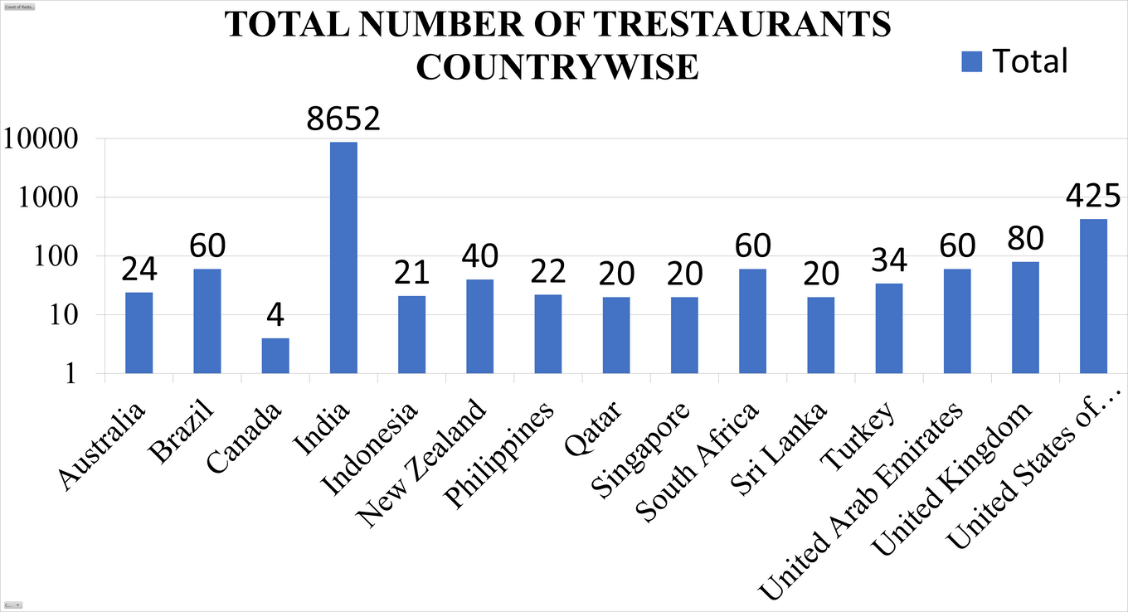
TOTAL NUMBER OF RESTAURANTS FROM EACH COUNTRY
India leads the list with a massive 8,542 restaurants, making it the biggest food hub by far. The USA comes next with 425 restaurants, followed by the UK with 80. Countries like Brazil, South Africa, and the UAE each have around 60, offering a fair variety of options, while others such as Turkey (34), New Zealand (40), and Australia (24) contribute smaller but interesting selections. At the lower end, places like Canada, Qatar, Singapore, and Sri Lanka have only a handful of restaurants, but each brings its own unique flavors to the table. Altogether, these countries add up to a total of 9,542 restaurants worldwide, showcasing a rich mix of global cuisines.

Slide 9
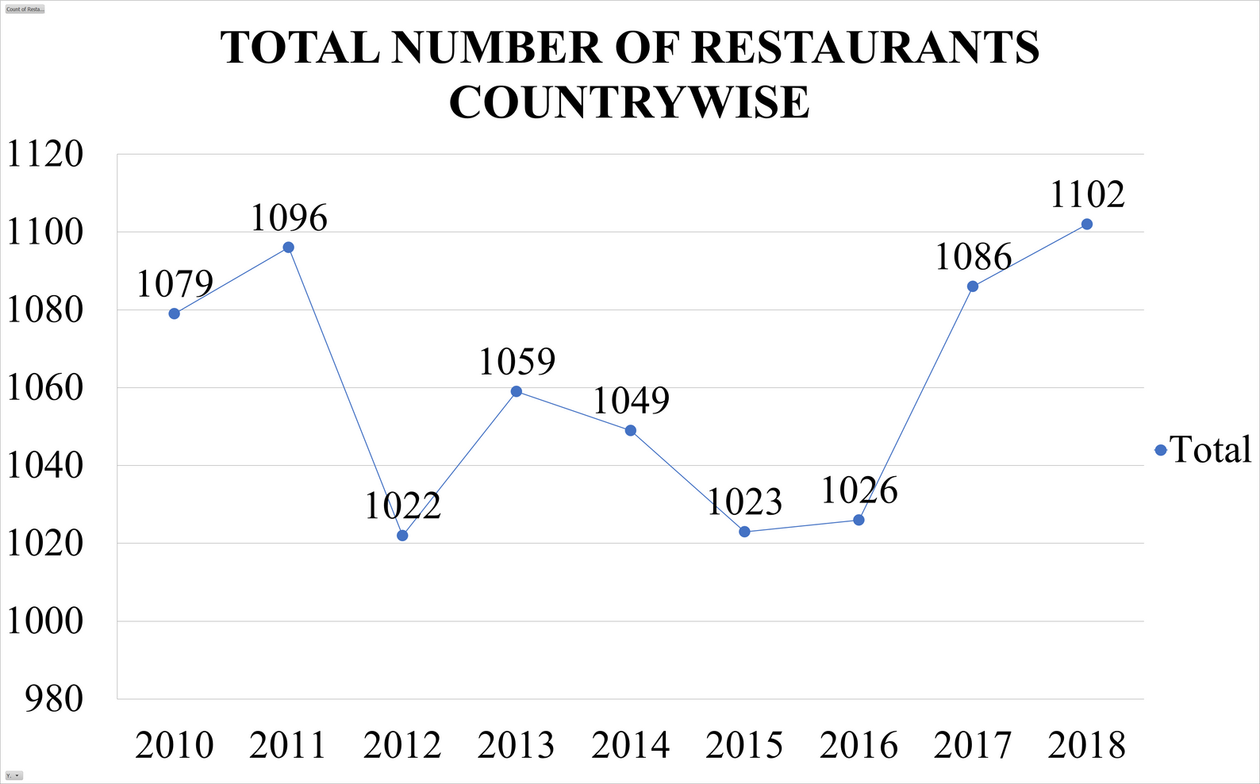
TOTAL NUMBER OF RESTAURANTS YEARWISE
2010: THE YEAR BEGAN WITH 1,079 RESTAURANTS, SETTING A STRONG BASE FOR THE FOLLOWING YEARS.
2011: SLIGHT GROWTH TO 1,096 RESTAURANTS, SHOWING A SMALL BUT POSITIVE INCREASE.
2012: A DROP TO 1,022 RESTAURANTS, THE LOWEST IN THE DATASET, POSSIBLY DUE TO CLOSURES OR REDUCED OPENINGS.
2013: NUMBERS BOUNCED BACK TO 1,059, RECOVERING FROM THE PREVIOUS YEAR’S DIP.
2014: SLIGHT DECREASE TO 1,049, MAINTAINING A STABLE PRESENCE OVERALL.
2015: SMALL DROP TO 1,023, MARKING ANOTHER LOW POINT CLOSE TO 2012’S FIGURES.
2016: MINOR IMPROVEMENT TO 1,026 RESTAURANTS, SHOWING STEADY STABILITY.
2017: GROWTH TO 1,086 RESTAURANTS, ONE OF THE STRONGER YEARS IN THE SERIES.
2018: REACHED THE HIGHEST COUNT AT 1,102 RESTAURANTS, MARKING THE PEAK IN THIS NINE-YEAR SPAN.
OVERALL: THE PERIOD SHOWS CONSISTENT NUMBERS WITH MINOR FLUCTUATIONS, TOTALING 9,542 RESTAURANTS ACROSS ALL YEARS.

Slide 10
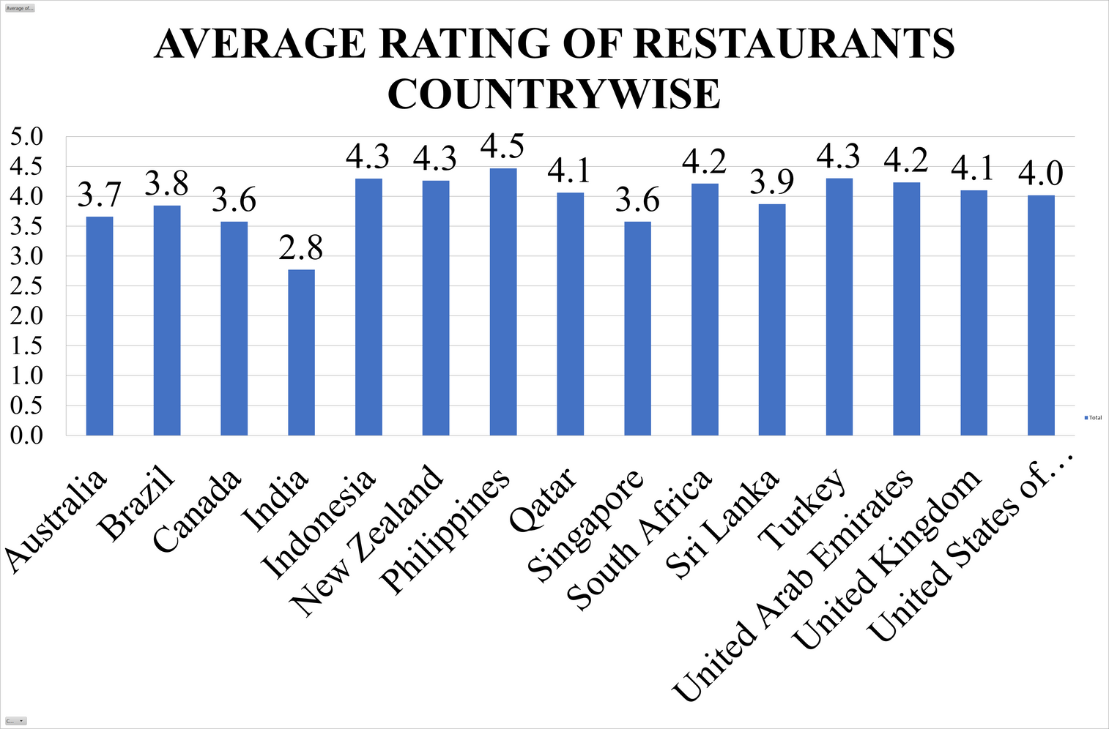
AVERAGE RATING OF RESTAURANTS COUNTRYWISE
HIGHEST RATINGS: THE PHILIPPINES LEADS WITH THE HIGHEST AVERAGE RATING OF 4.5, FOLLOWED BY INDONESIA, NEW ZEALAND, AND TURKEY AT 4.3 EACH.
STRONG PERFORMERS: SOUTH AFRICA AND THE UAE HAVE 4.2, WHILE QATAR AND THE UK SCORE 4.1.
MID-RANGE RATINGS: THE USA AVERAGES 4.0, SRI LANKA 3.9, AND BRAZIL 3.8.
LOWER RATINGS: AUSTRALIA AND SINGAPORE SHARE 3.6–3.7, CANADA HAS 3.6, AND INDIA RECORDS THE LOWEST AVERAGE RATING AT 2.8.
INSIGHT: MOST COUNTRIES HAVE RATINGS ABOVE 4, INDICATING GENERALLY POSITIVE DINING EXPERIENCES, BUT INDIA AND A FEW OTHERS FALL BEHIND, SUGGESTING POSSIBLE QUALITY OR SERVICE CHALLENGES.

Slide 11
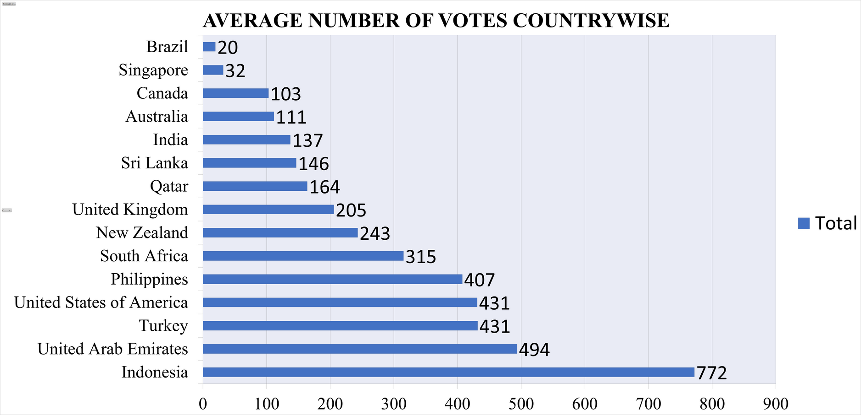
AVERAGE RATING OF RESTAURANTS COUNTRYWISE
Highest Engagement: Indonesia tops the list with an impressive 772 average votes, far above other countries.
Strong Voting Activity: The UAE follows with 494, while Turkey and the USA share 431 each.
Moderate Levels: The Philippines averages 407, South Africa 315, and New Zealand 243.
Lower but Notable Votes: The UK (205), Qatar (164), Sri Lanka (146), and India (137) show moderate customer engagement.
Lowest Engagement: Australia (111), Canada (103), Singapore (32), and Brazil (20) have the smallest average voting activity.

Slide 12
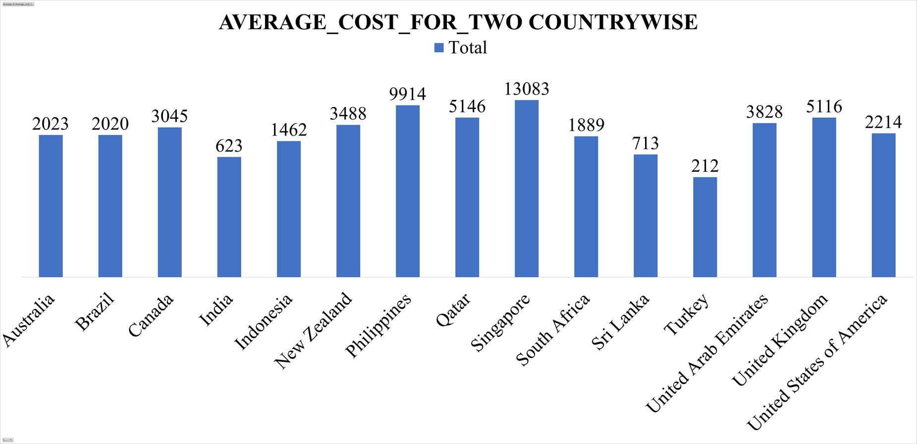
AVERAGE _COST_FOR_TWO COUNTRYWISE
Most Expensive: Singapore stands out with the highest average at ₹13,083, followed by the Philippines (₹9,914) and Qatar (₹5,146).
High Costs: The UK (₹5,116), UAE (₹3,828), and New Zealand (₹3,488) also have relatively high dining costs.
Moderate Costs: Canada (₹3,045), USA (₹2,214), Australia (₹2,023), Brazil (₹2,020), and South Africa (₹1,889) fall in the mid-range.
Lower Costs: Indonesia averages ₹1,462, Sri Lanka ₹713, and India ₹623.
Least Expensive: Turkey is the most affordable, with just ₹212 on average for two people.

Slide 13
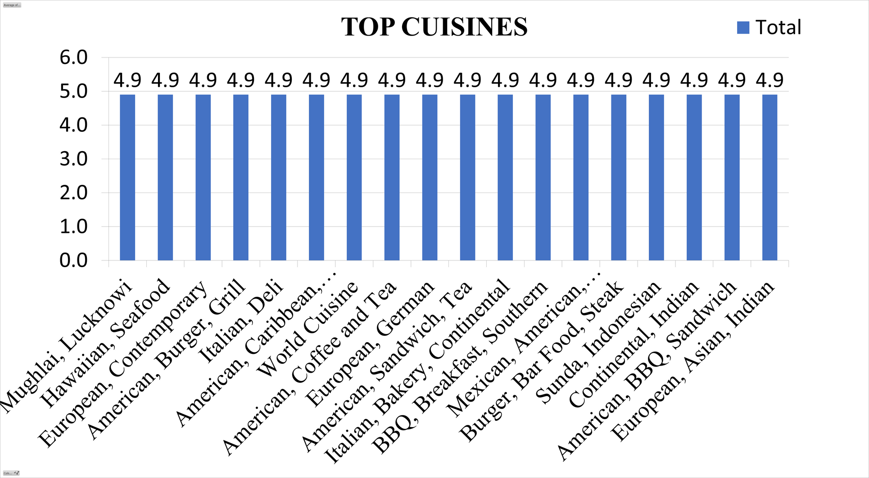
CHOICE OF CUISINE
According to my analysis, most individuals prefer their local cuisine over foreign cuisines, and restaurants that serve local cuisine and have higher ratings tend to receive better feedback. Thus, I've chosen a few regional dishes as well as a few more that received better reviews.
Here are the top five cuisines in the suggested countries based on customer feedback

Slide 14
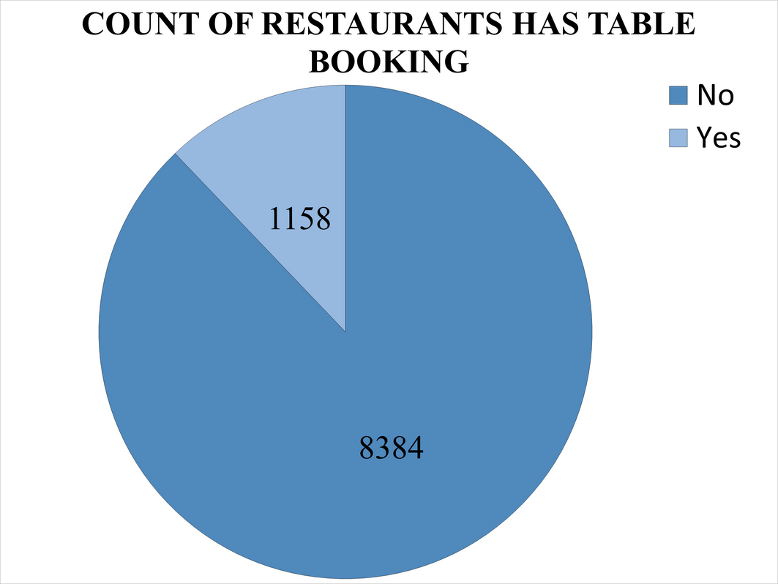
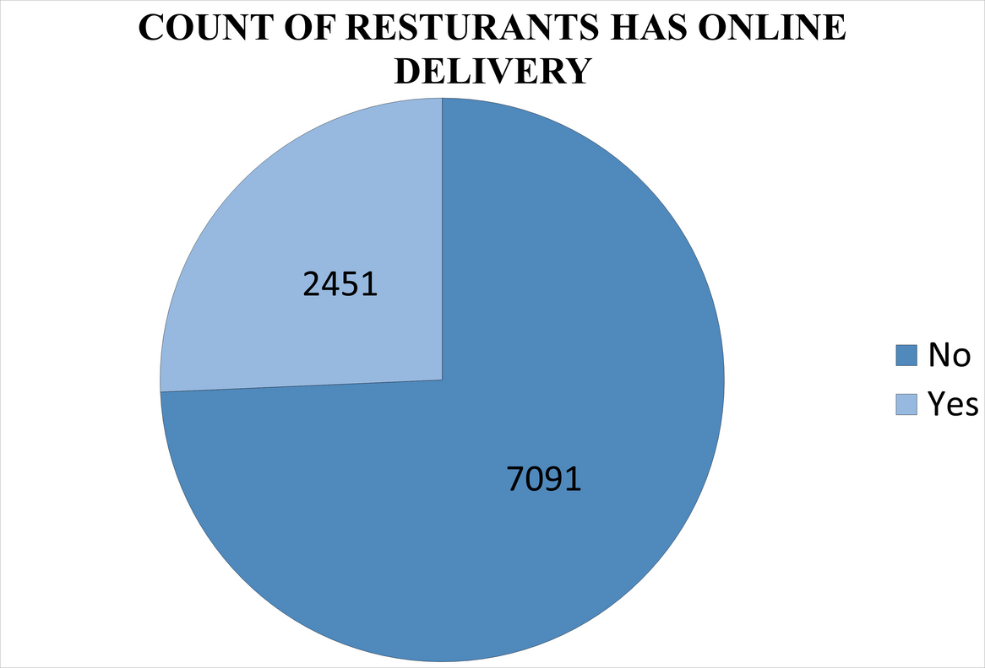
MODE OF BOOKING
Table Booking
Only 1,158 restaurants (about 12%) offer table booking.
A large majority (8,384 restaurants, ~88%) do not have a table booking facility.
Online Delivery
2,451 restaurants (about 26%) offer online delivery.
7,091 restaurants (~74%) do not offer online delivery.

Slide 15
KEY INSIGHTS TO IMPROVE PERFORMANCE IN LOW RATING AREAS
Recommendation:
Identify and address the issues in regions with lower average ratings.
1.Data-Driven Reason:
•Analysis of low-rated restaurants can reveal common drawback such as poor service, food quality, or ambience, which need to be rectiﬁed
2.Expected Impact:
•Enhanced Customer Satisfaction: By addressing these issues, Zomato can improve overall customer experience, leading to better rating reviews.
•Strengthened Market Position: Elevating performance in low-rated areas can reduce the risk of losing customers to competitors and improve Zomato's reputation in these regions.

Slide 16
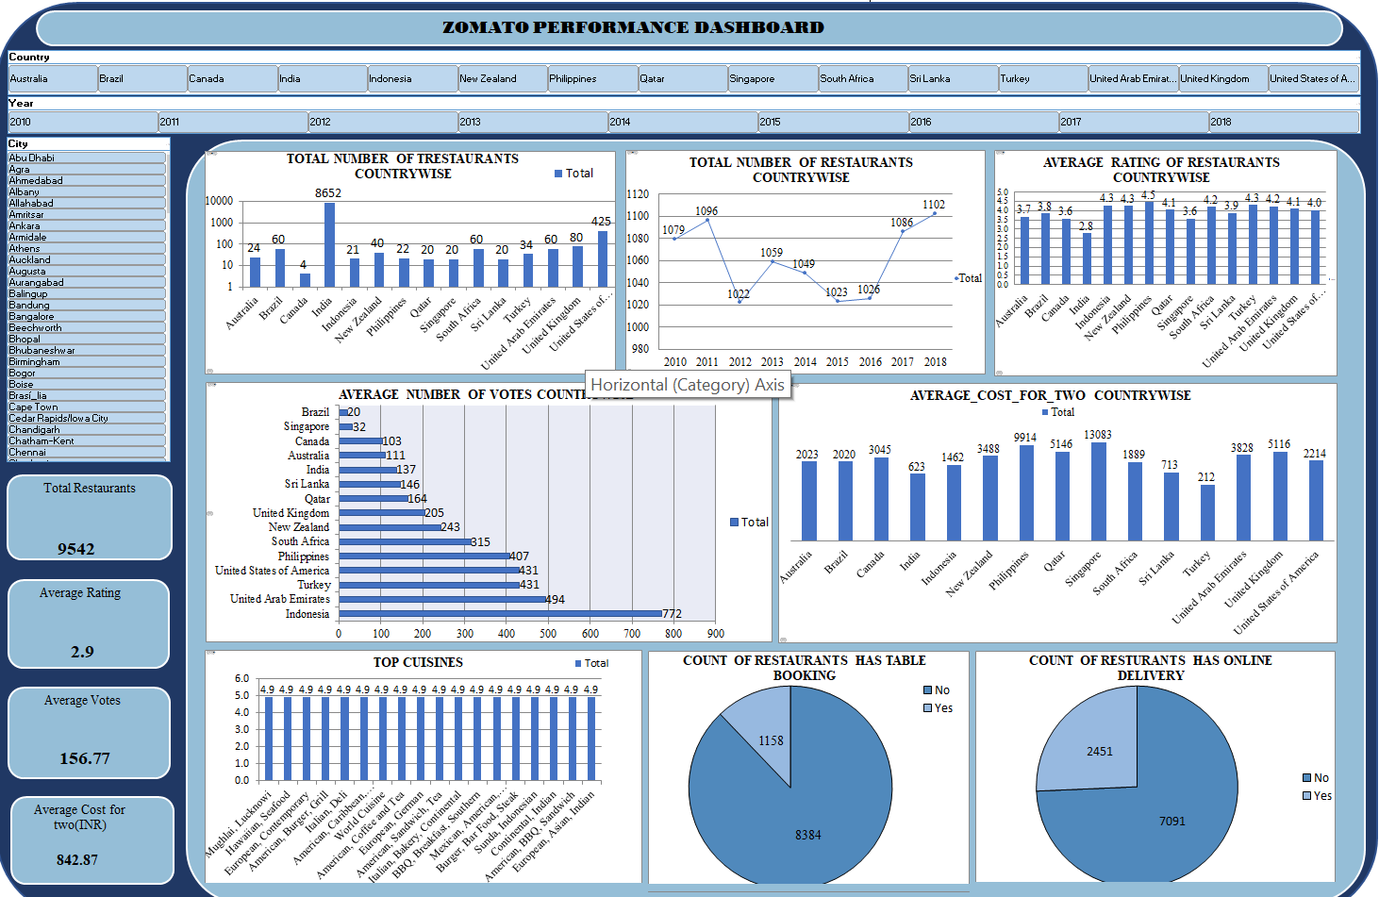
DASHBOARD

Slide 17
CONCLUSION
Countries to be considered for opening new restaurants :
Qatar, Canada, Singapore, Sri lanka, India
Cities to be considered for opening new restaurants:
Doha, Consort, Yorkton, Singapore, Colombo, Aurangabad, Allahabad, Ghaziabad.
We should provide Online Table Booking facility in our new restaurants
We should provide Online Delivery facility also
Interpretation:
City/Regio : Identifies areas with high average ratings for potential expansion.
•Rating Distribution : Bar charts and scatter plots categorize restaurants by ratings for quick assessments.
•Time Series Analysis : Line charts illustrate yearly restaurant openings for market growth insights.
Interactivity
•Filters and Slicers : The dashboard includes ﬁlters for selecting speciﬁc cities, years or rating ranges, making it easier to drill down into the data for more detailed analysis.
Example: Users can ﬁlter the dashboard to view only high-rated restaurants in a particular city, helping to focus on top-performing areas for strategic decision-making

